Slide 1

Design Patterns
System Team QA
Project RAIDER

Slide 2
Agenda
Introduction
What is a Design Pattern?
What doe s the patterns consist of?
Classification
Creational Design Patterns
Factory Method
Abstract Factory
Builder
Structural Design Patterns
Facade
Behavioral Design Patterns
Strategy
Observer
Template Method

Slide 3
Introduction - What is a Design Pattern?
Design patterns are typical solution to commonly occurring problems in software design.
Design patterns are templates and general concepts for solving a particular problem. They are not just a piece of code you can copy into your program.
The patterns are not algorithms but a more high-level description of a solution.

Slide 4
Introduction - What does the patterns consist of?
Most patterns are described formally so you can reproduce them in many context. They normally consist of the following sections:
Intent
Motivation
Structure
Code example

Slide 5
Introduction - Classification
The most basic and low-level patterns are often called idioms. They usually apply only to a single programming language.
The most universal and high-level patterns are architectural patterns. They can be implemented in virtually any language.
They can also be categorized by their intent:
Creational patterns provide object creation mechanisms that increase flexibility and reuse of existing code.
Structural patterns explain how to assemble objects and classes into larger structures, while keeping the structures flexible and efficient.
Behavioral patterns take care of effective communication and assignment of responsibility between objects.

Slide 6
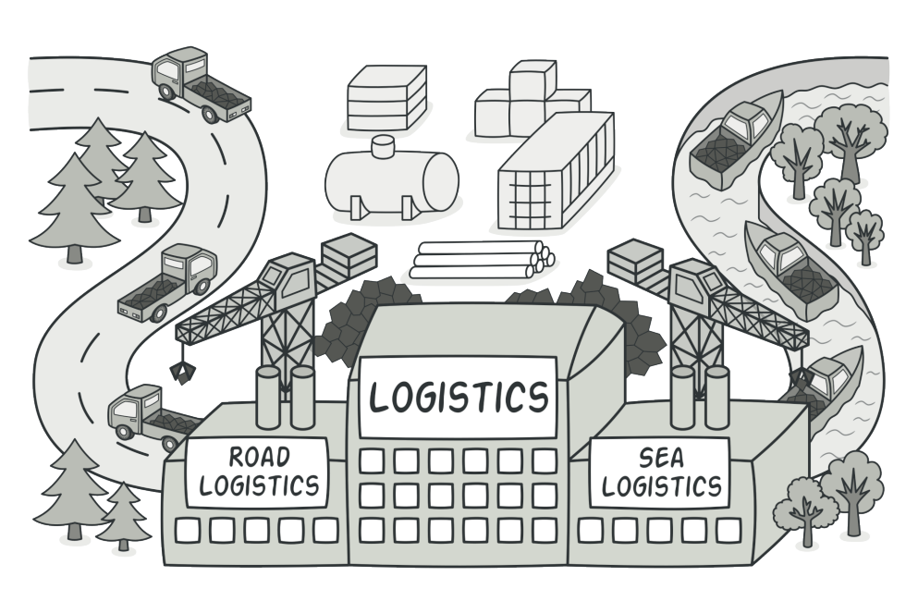
Creational Design Patterns – Factory Method - Intent
Factory Method is a creational design pattern that provides an interface for creating objects in a superclass but allow subclasses to alter the type of objects that will be created.

Slide 7
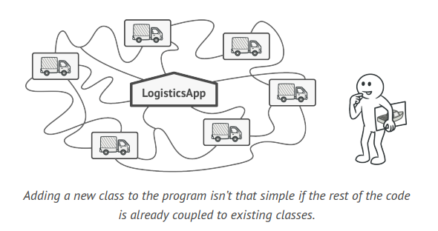
Creational Design Patterns – Factory Method – Motivation – The Problem

Slide 8
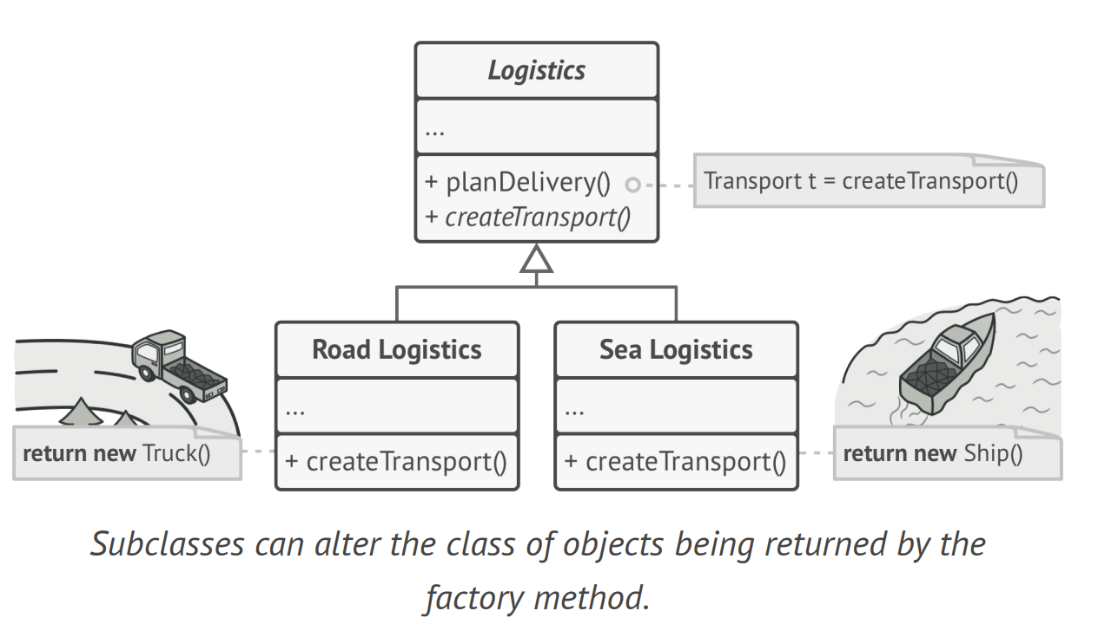
Creational Design Patterns – Factory Method – Motivation – The Solution

Slide 9
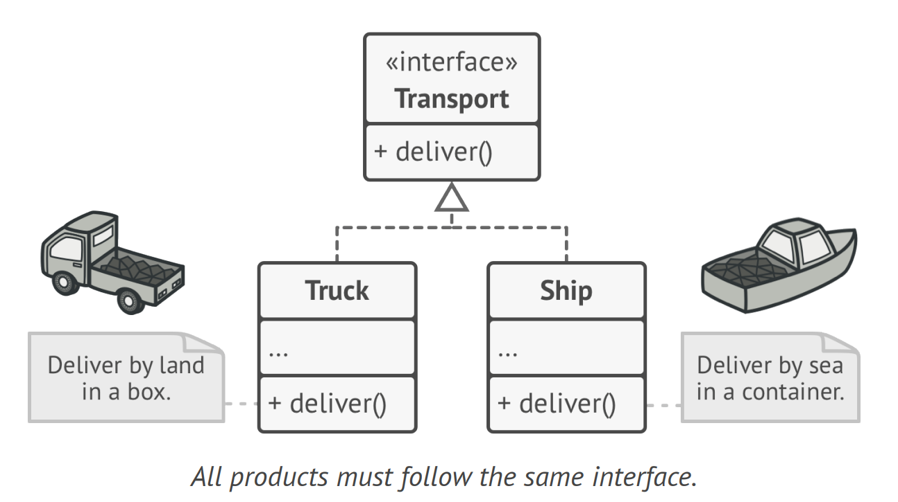
Creational Design Patterns – Factory Method – Motivation – The Solution

Slide 10
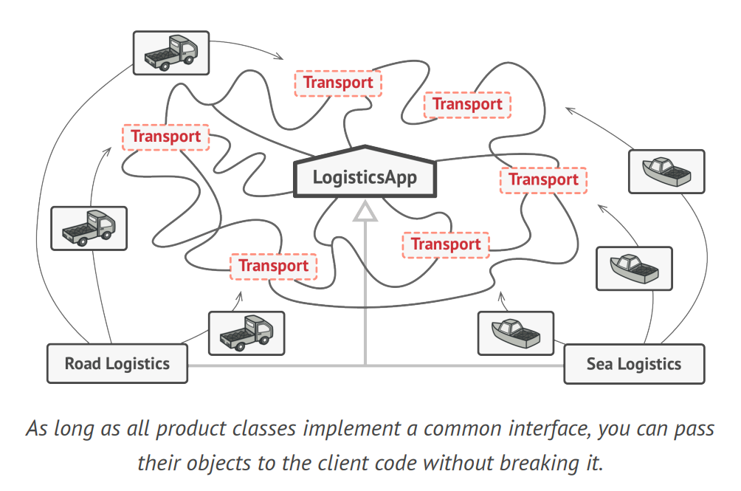
Creational Design Patterns – Factory Method – Motivation – The Solution

Slide 11
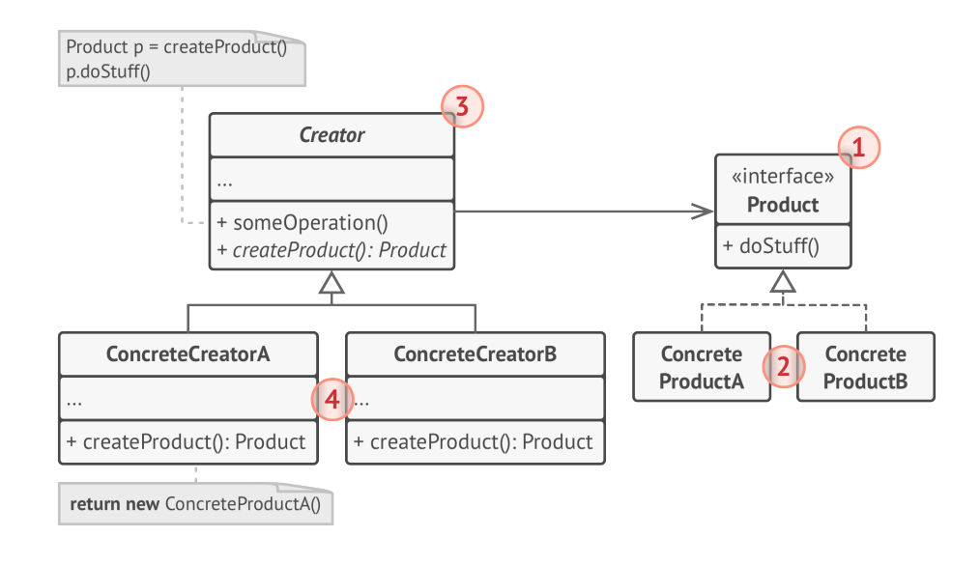
Creational Design Patterns – Factory Method - Structure

Slide 12
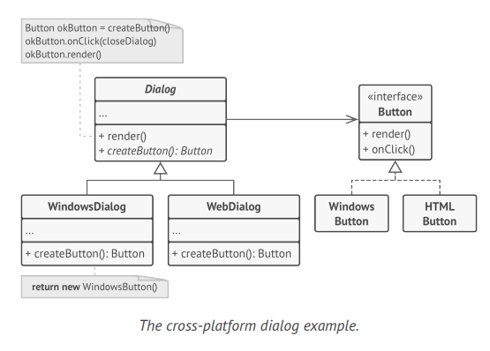
Creational Design Patterns – Factory Method - Example
Pseudocode: Factory Method (refactoring.guru)

Slide 13
Creational Design Patterns – Factory Method - Applicability
When you don’t know beforehand the exact types and dependencies of the objects your code should work with
When you want to provide users of your library or framework with a way to extend its internal components
When you want to save system resources by reusing existing objects instead of rebuilding them each time

Slide 14
Creational Design Patterns – Factory Method – Pros and Cons
Pros
You avoid tight coupling between the creator and the concrete products
Single Responsibility Principle: you can move the product creation code into one place in the program
Open/Close Principle: You can introduce new types o product into the program without breaking existing client code
Cons
The code may become more complicate since you need to introduce a lot of new subclasses to implement the pattern. The best-case scenario is when you are introducing the pattern into an existing hierarchy of creator classes.

Slide 15
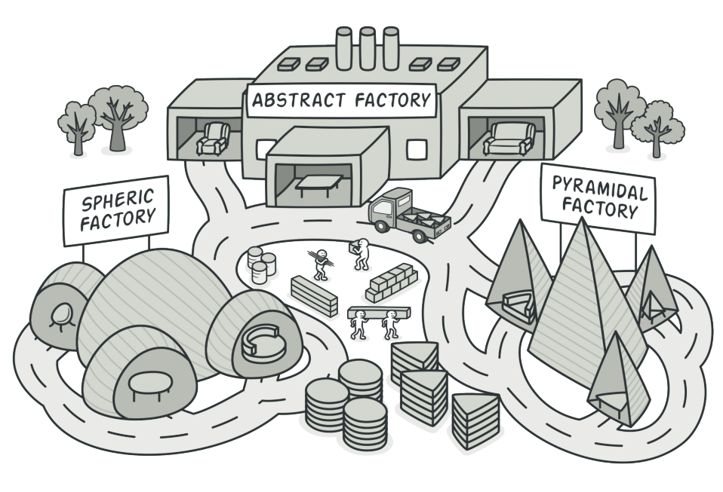
Creational Design Patterns – Abstract Factory - Intention
Abstract Factory is a creational design pattern that lets you produce families of related objects without specifying their concrete classes

Slide 16
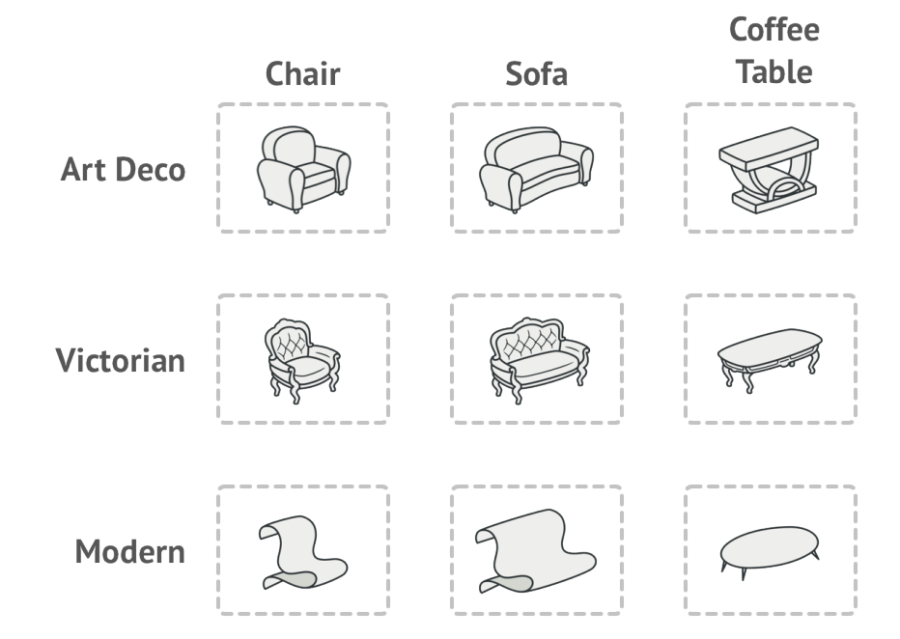
Creational Design Patterns – Abstract Factory – Motivation – The Problem

Slide 17
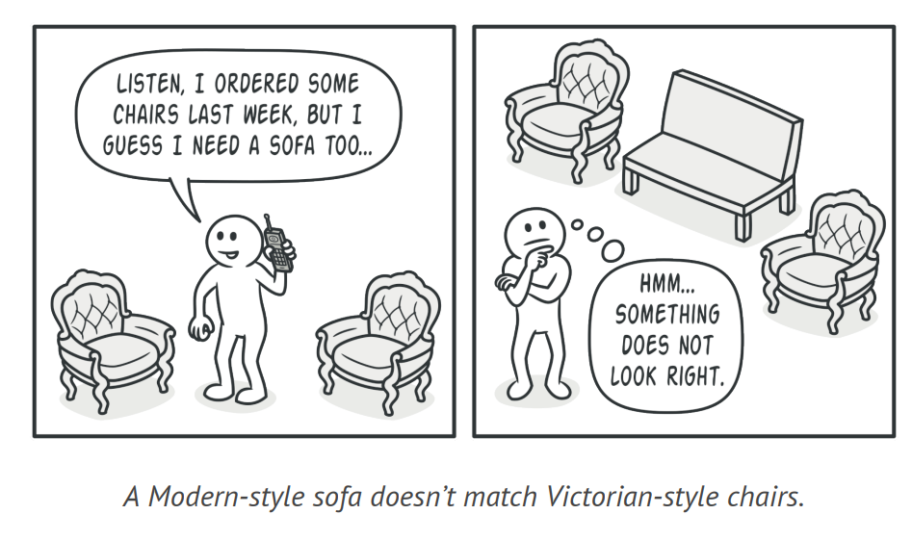
Creational Design Patterns – Abstract Factor – Motivation – The Problem

Slide 18
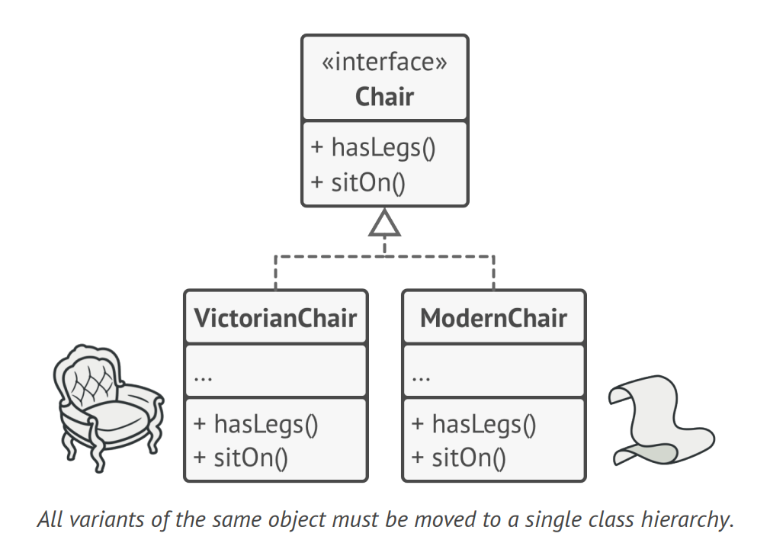
Creational Design Patterns – Abstract Factory - The Solution

Slide 19
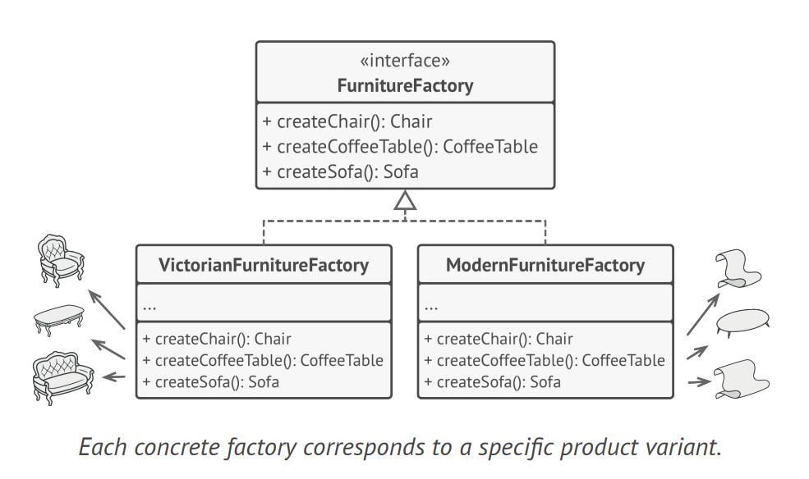
Creational Design Patterns – Abstract Factory - The Solution

Slide 20
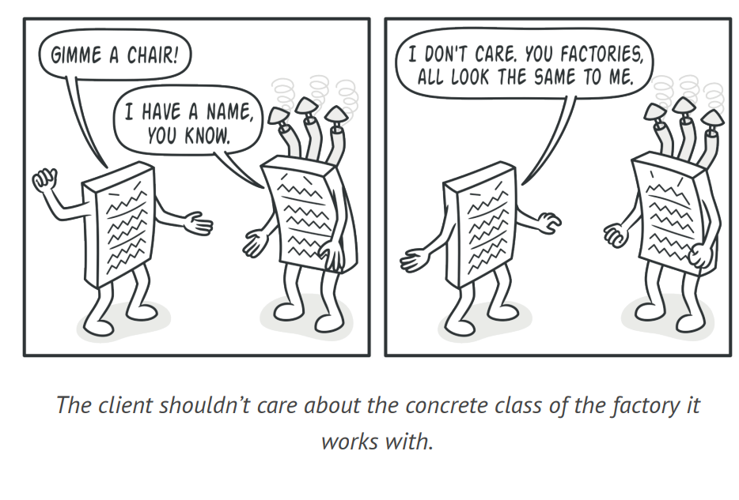
Creational Design Patterns – Abstract Factory - The Solution

Slide 21
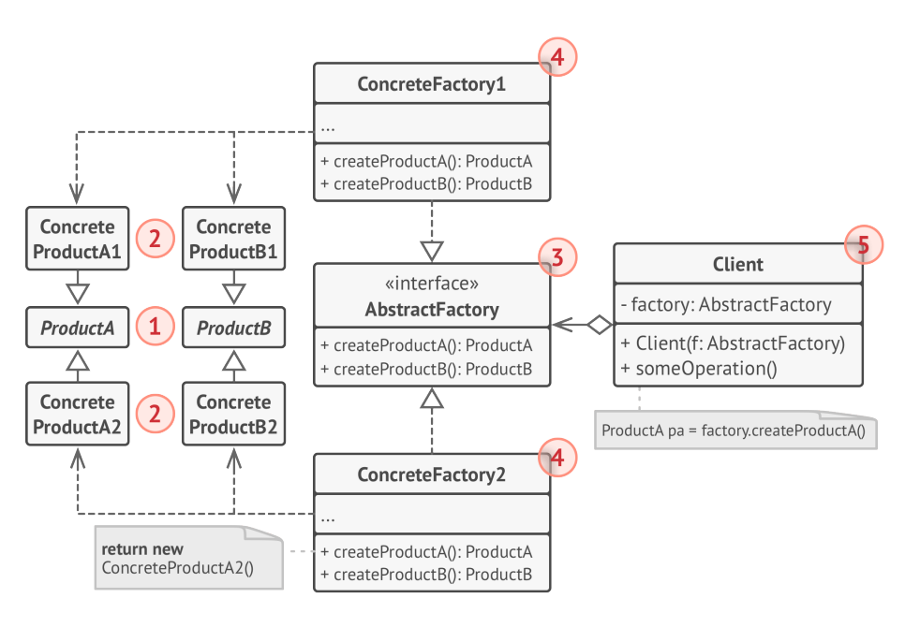
Creational Design Patterns – Abstract Factory - Structure

Slide 22
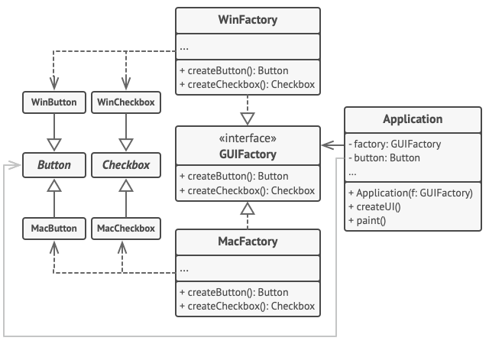
Creational Design Patterns – Abstract Factory - Sample
Pseudocode: Abstract Factory (refactoring.guru)

Slide 23
Creational Design Patterns – Abstract Factory - Applicability
When your code needs to work with various families of related products, but you don’t want it to depend on the concrete classes of those products—they might be unknown beforehand, or you simply want to allow for future extensibility

Slide 24
Creational Design Patterns – Abstract Factory – Pros and Cons
Pros
You can be sure that the products you’re getting from a factory are compatible with each other
You avoid tight coupling between concrete products and client code
Single Responsibility Principle: you can move the product creation code into one place in the program
Open/Close Principle: You can introduce new variants of products without breaking existing client code
Cons
The code may become more complicate since you need to introduce a lot of new subclasses to implement the pattern.

Slide 25
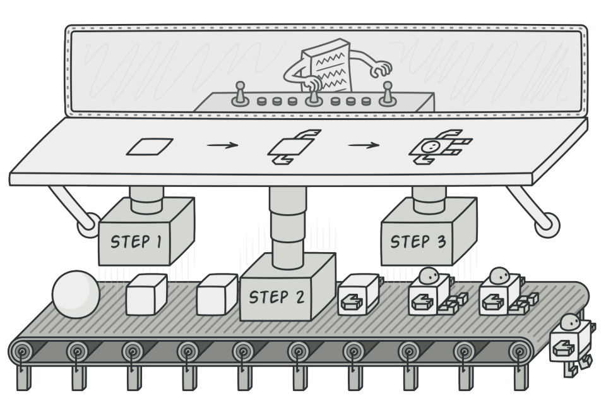
Creational Design Patterns – Builder - Intention
Builder is a creational design pattern that lets you construct complex objects step by step. The pattern allows you to produce different types and representations of an object using the same construction code

Slide 26
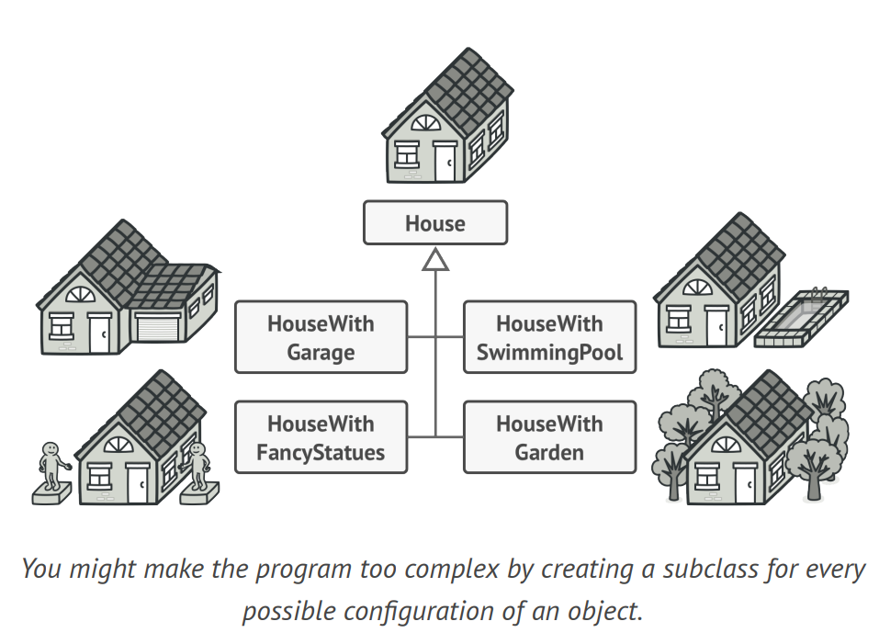
Creational Design Patterns – Builder – The Problem

Slide 27
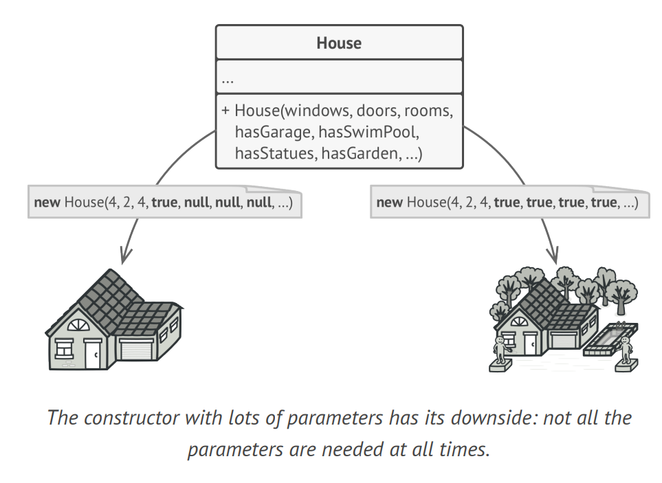
Creational Design Patterns – Builder – The Problem

Slide 28
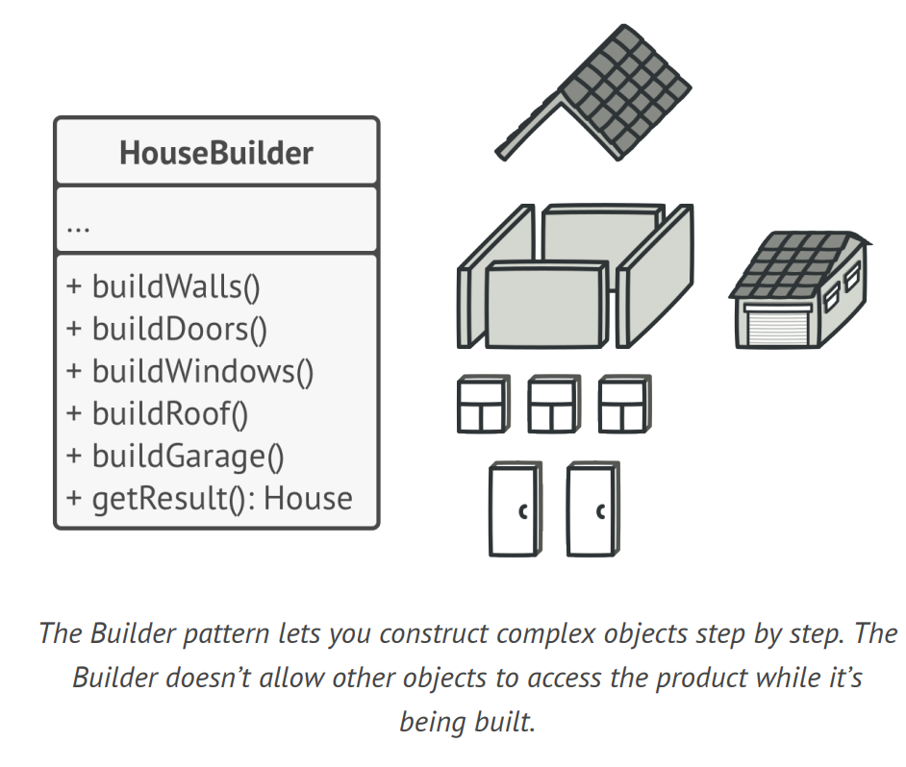
Creational Design Patterns – Builder – The Solution

Slide 29
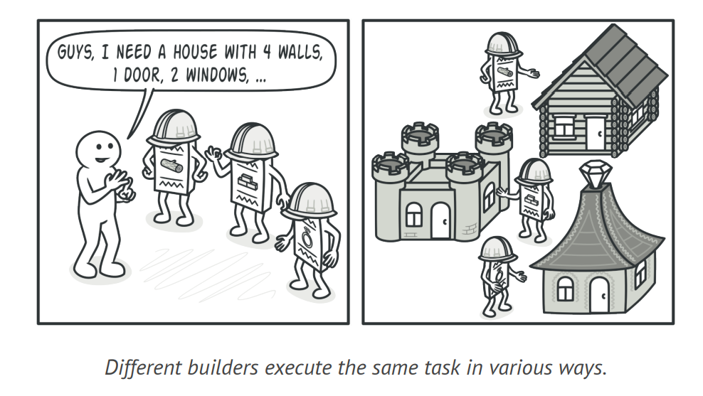
Creational Design Patterns – Builder – The Solution

Slide 30
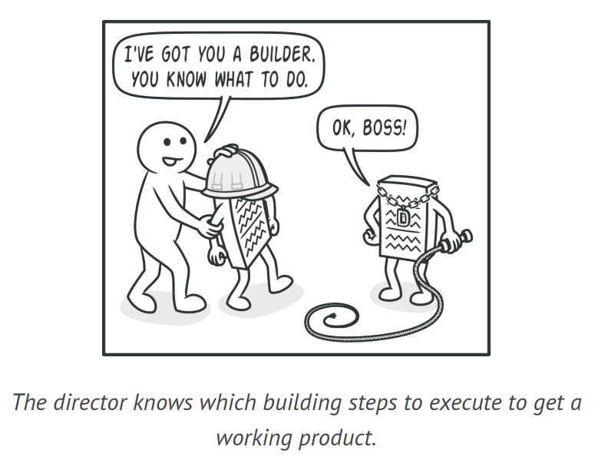
Creational Design Patterns – Builder – The Solution

Slide 31
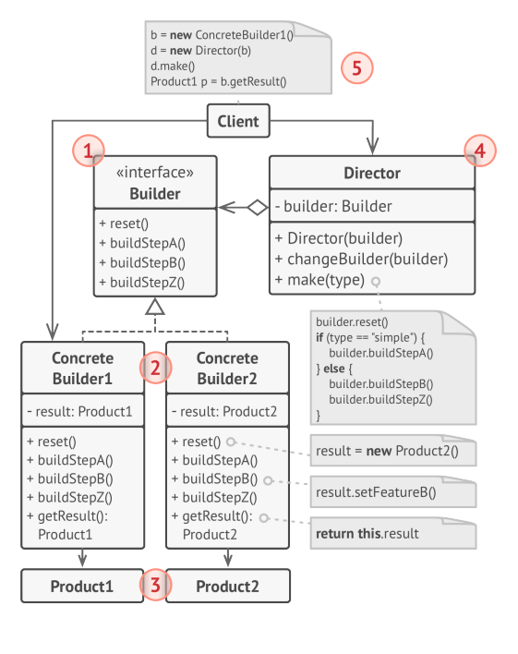
Creational Design Patterns – Builder – Structure

Slide 32
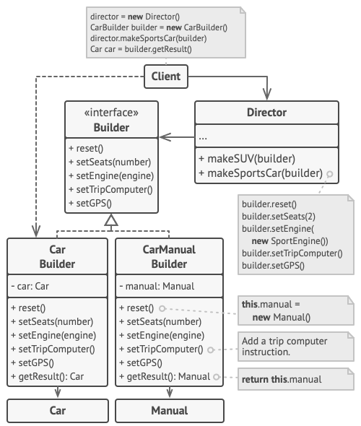
Creational Design Patterns – Builder – Sample
Pseudocode: Builder (refactoring.guru)

Slide 33
Creational Design Patterns – Builder – Applicability
Use the Builder pattern to get rid of a “telescopic constructor”
When you want your code to be able to create different representations of some product (for example, stone and wooden houses).

Slide 34
Creational Design Patterns – Builder – Pros and Cons
Pros
You can reuse the same construction code when building various representations of the products.
Single Responsibility Principle: you can isolate complex construction code from the business logic of the product
Cons
The overall complexity of the code increases since the pattern requires creating multiple new classes.

Slide 35
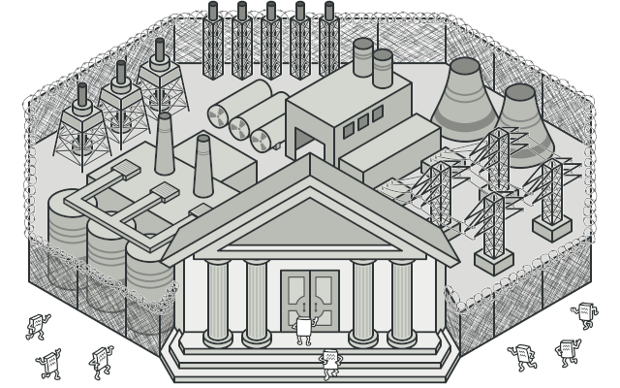
Structural Design Patterns – Facade - Intention
Facade is a structural design pattern that provides a simplified interface to a library, a framework, or any other complex set of classes.

Slide 36
Structural Design Patterns – Facade – The Problem
If you must make your code work with a broad set of objects that belong to a sophisticated library or framework, you would need to initialize all those objects, keep track of the dependencies, execute methods in the correct order and so on.
As a result, the business logic of your classes would become tightly coupled to the implementation details of third-party classes.

Slide 37
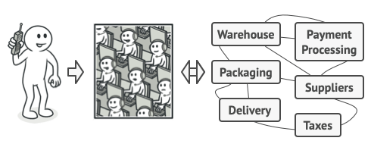
Structural Design Patterns – Facade – The Solution

Slide 38
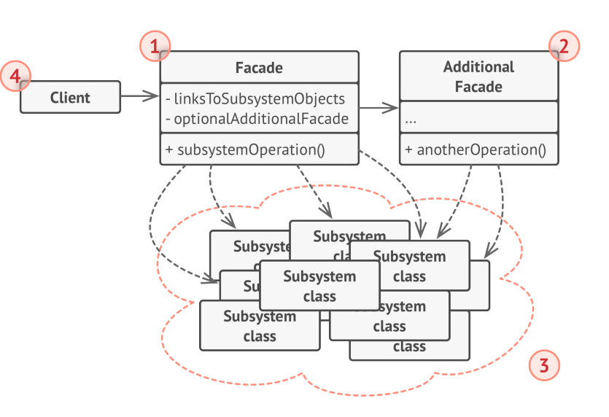
Structural Design Patterns – Facade – Structure

Slide 39
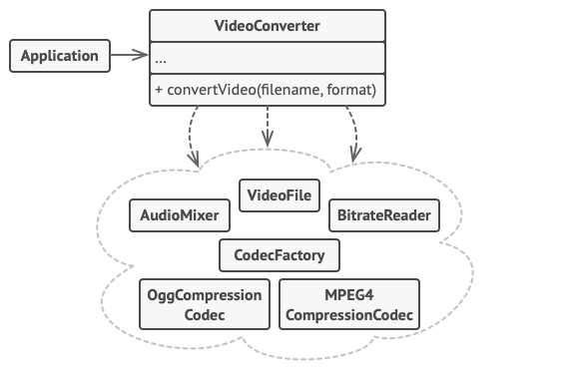
Structural Design Patterns – Facade – Sample
Pseudocode: Facade (refactoring.guru)

Slide 40
Structural Design Patterns – Facade – Applicability
When you need to have a limited but straightforward interface to a complex subsystem.
When you want to structure a subsystem into layers.

Slide 41
Structural Design Patterns – Facade – Pros and Cons
Pros
You can isolate your code from the complexity of a subsystem.
Cons
A facade can become a god object coupled to all classes of an app.

Slide 42
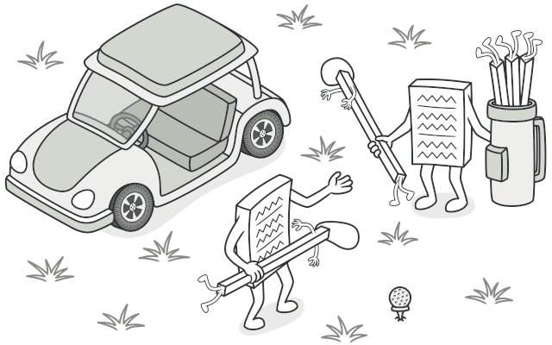
Behavioral Design Patterns – Strategy - Intention
Strategy is a behavioral design pattern that lets you define a family of algorithms, put each of them into a separate class, and make their objects interchangeable.

Slide 43
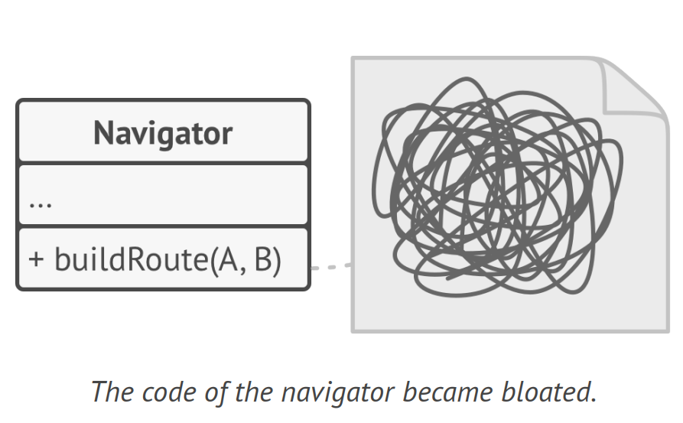
Behavioral Design Patterns – Strategy – The Problem

Slide 44
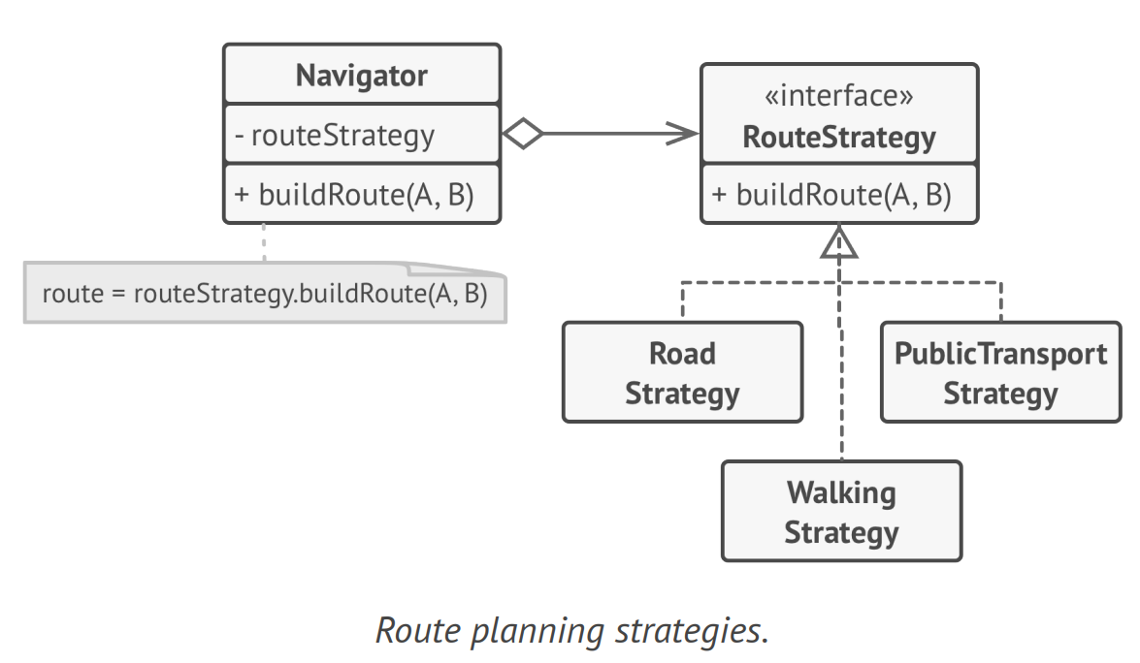
Behavioral Design Patterns – Strategy – The Solution

Slide 45
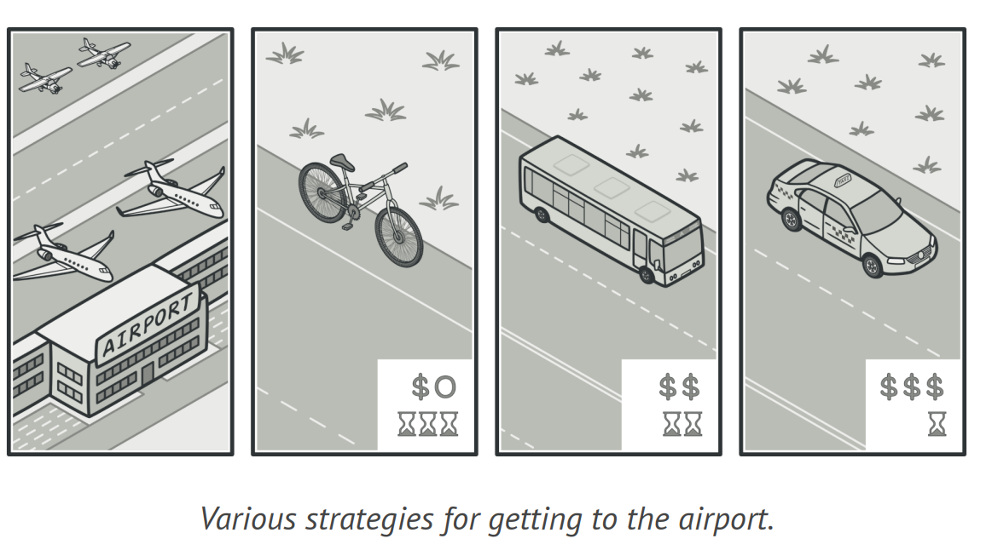
Behavioral Design Patterns – Strategy – The Solution

Slide 46
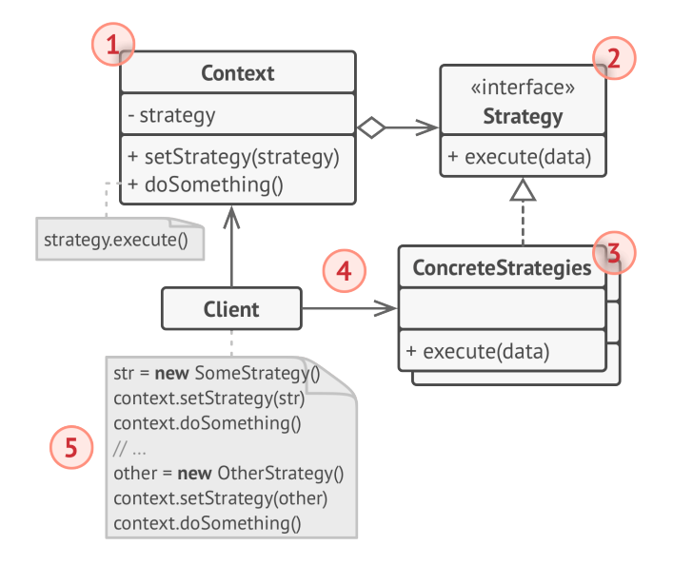
Behavioral Design Patterns – Strategy – Structure

Slide 47
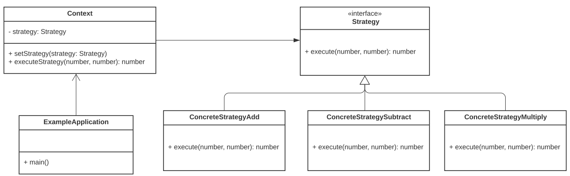
Behavioral Design Patterns – Strategy – Sample
Pseudocode: Strategy (refactoring.guru)

Slide 48
Behavioral Design Patterns – Strategy – Applicability
When you want to use different variants of an algorithm within an object and be able to switch from one algorithm to another during runtime.
When you have many similar classes that only differ in the way they execute some behavior.
When you need to isolate the business logic of a class from the implementation details o algorithms that may not be as important in the context of that logic.
When your class has a massive conditional operator that switches between different variants of the same algorithm.

Slide 49
Behavioral Design Patterns – Strategy – Pros and Cons
Pros
You can swap algorithms used inside an object at runtime.
You can isolate the implementation details of an algorithm from the code that uses it.
You can replace inheritances with composition.
Open/Closed Principle: you can introduce new strategies without having to change the context
Cons
If you have a couple of algorithms that rarely change, there is no real reason to overcomplicate the program with the new classes and interfaces that come along with the pattern.
Clients must be aware of the differences between strategies.
A lot of modern programming languages have functional type support that lets you implement different versions of an algorithm inside a set of anonymous functions.

Slide 50
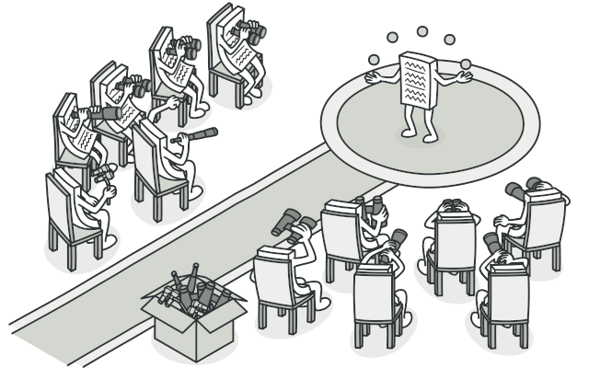
Behavioral Design Patterns – Strategy - Intention
Observer is a behavioral design pattern that lets you define a subscription mechanism to notify multiple objects about any events that happen to the object they are observing

Slide 51
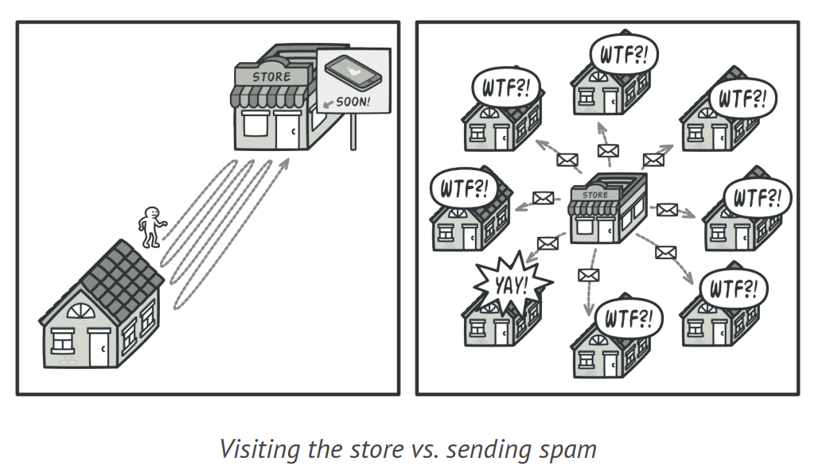
Behavioral Design Patterns – Observer – The Problem

Slide 52
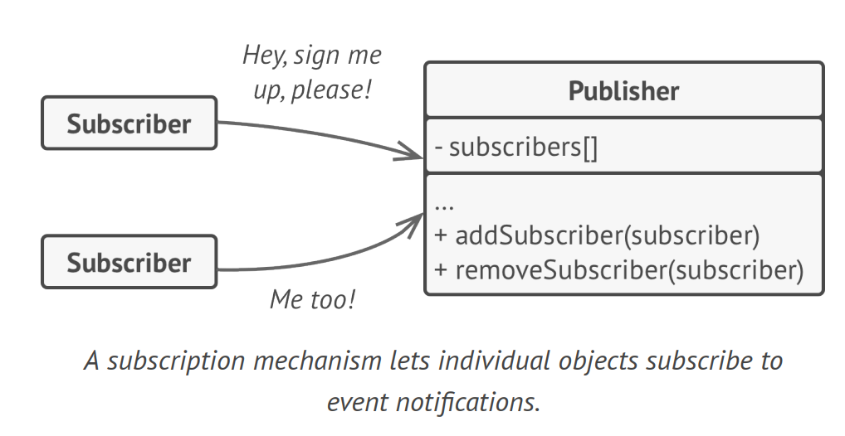
Behavioral Design Patterns – Observer – The Solution

Slide 53
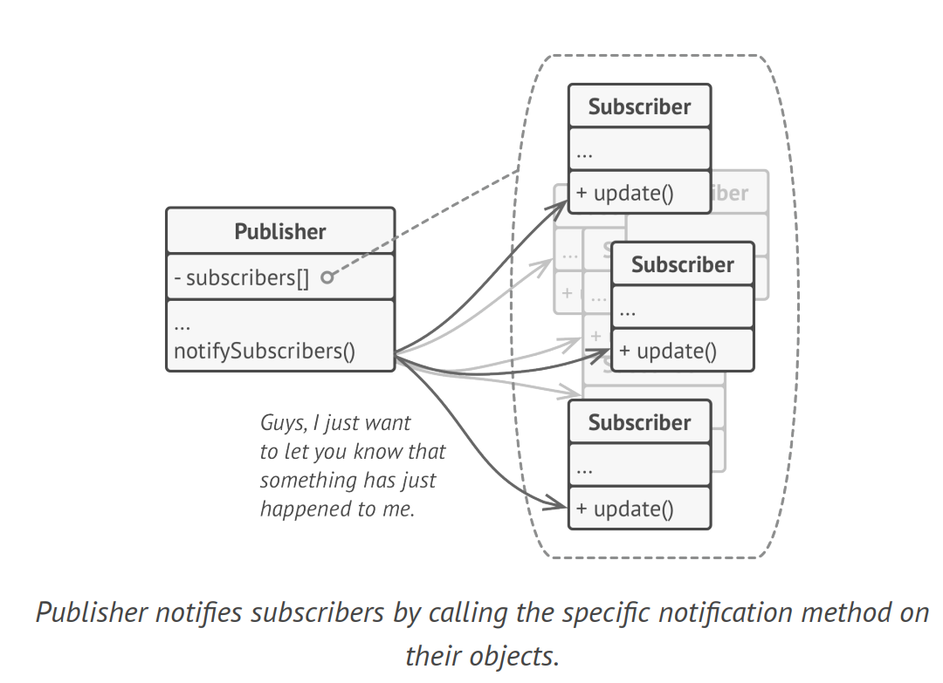
Behavioral Design Patterns – Observer – The Solution

Slide 54
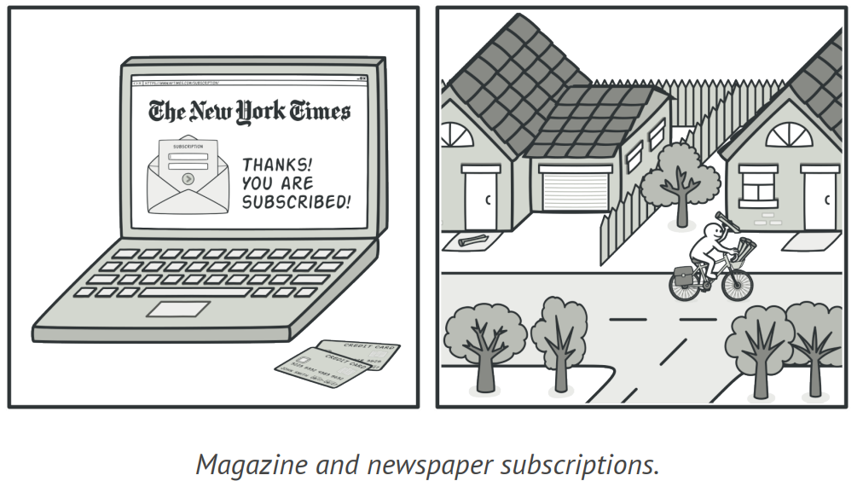
Behavioral Design Patterns – Observer – The Solution

Slide 55
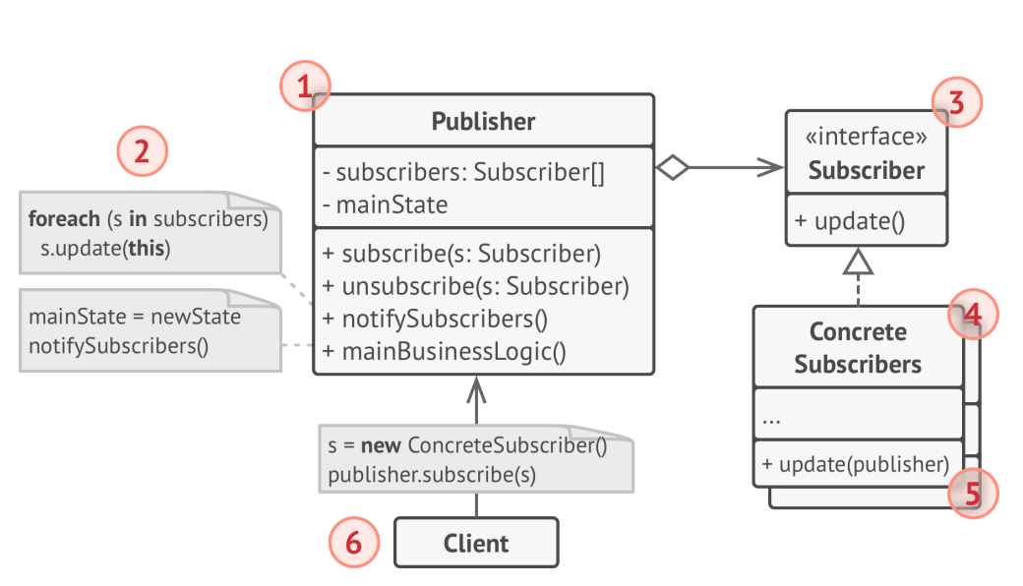
Behavioral Design Patterns – Observer – Structure

Slide 56
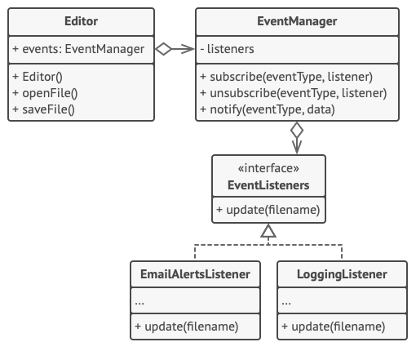
Behavioral Design Patterns – Observer – Sample
Pseudocode: Observer (refactoring.guru)

Slide 57
Behavioral Design Patterns – Observer – Applicability
When changes to the sate of one object may require changing other objects, and the actual set of objects is unknown beforehand or changes dynamically.
When some objects in your app must observe others, but only for a limited time or in specific cases

Slide 58
Behavioral Design Patterns – Observer – Pros and Cons
Pros
Open/Closed Principle: you can introduce new subscriber classes without having to change the publisher’s code.
You can establish relations between objects at runtime.
Cons
Subscribers are notified in random order.

Slide 59
Behavioral Design Patterns – Template Method - Intention
Templated Method is a behavioral design pattern that defines the skeleton of an algorithm in the superclass but lets subclasses override specific steps of the algorithm without changing its structure.

Slide 60
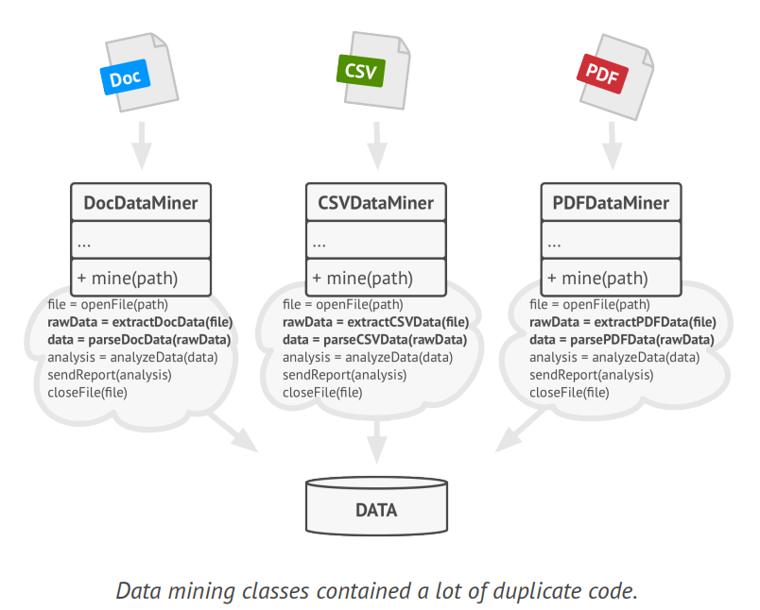
Behavioral Design Patterns – Template Method – The Problem

Slide 61
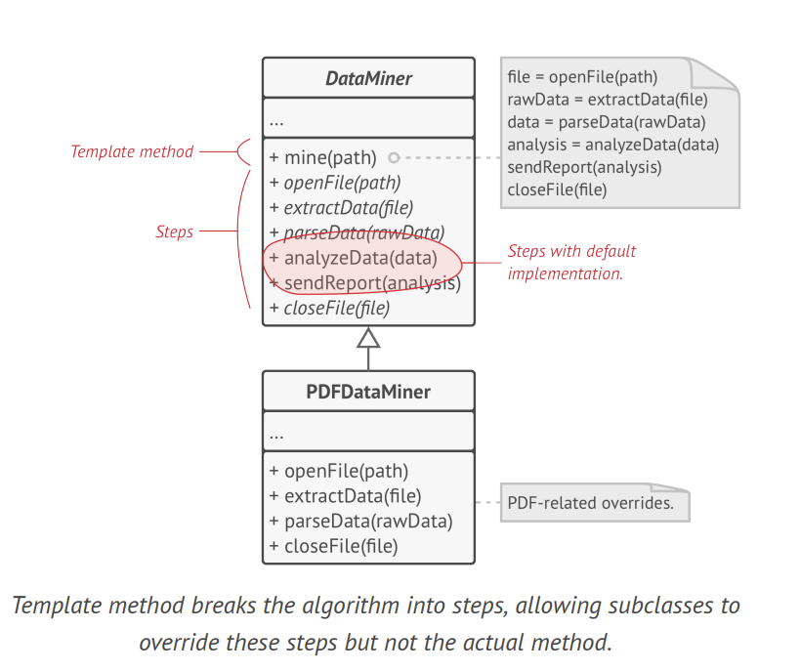
Behavioral Design Patterns – Template Method – The Solution

Slide 62
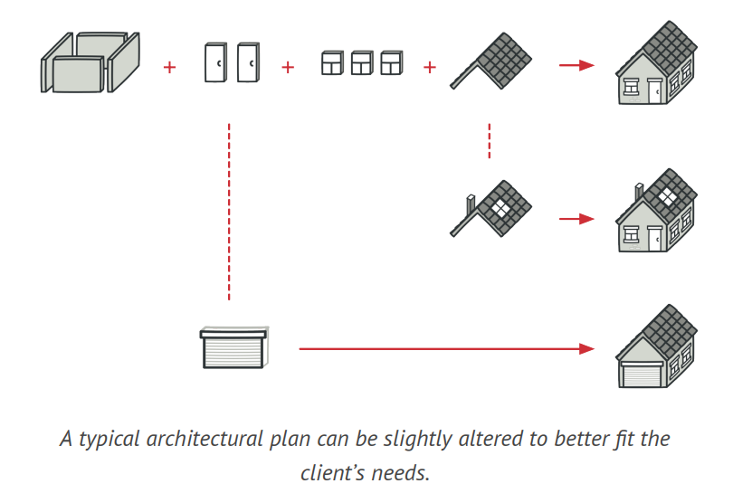
Behavioral Design Patterns – Template Method – The Solution

Slide 63
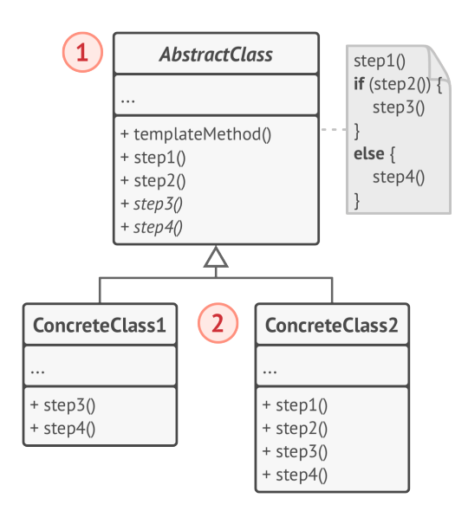
Behavioral Design Patterns – Template Method – Structure

Slide 64
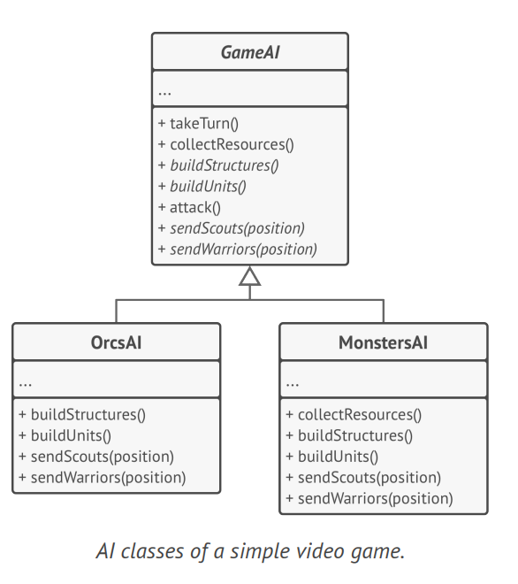
Behavioral Design Patterns – Template Method – Sample
Pseudocode: Template Method (refactoring.guru)

Slide 65
Behavioral Design Patterns – Template Method – Applicability
When you want to let clients extend only particular steps of an algorithm.
When you have several classes that contain almost identical algorithms with some minor differences.

Slide 66
Behavioral Design Patterns – Template Method – Pros and Cons
Pros
You can let clients override only certain parts of a large algorithm.
You can pull the duplicate code into a superclass.
Cons
Some clients may be limited by the provided skeleton of an algorithm.
You might violate the Liskov Substitution Principle by suppressing a default step implementation via a subclass.
Template methods tend to be harder to maintain the more steps they have.

Slide 67
Thank you

